Slide 1
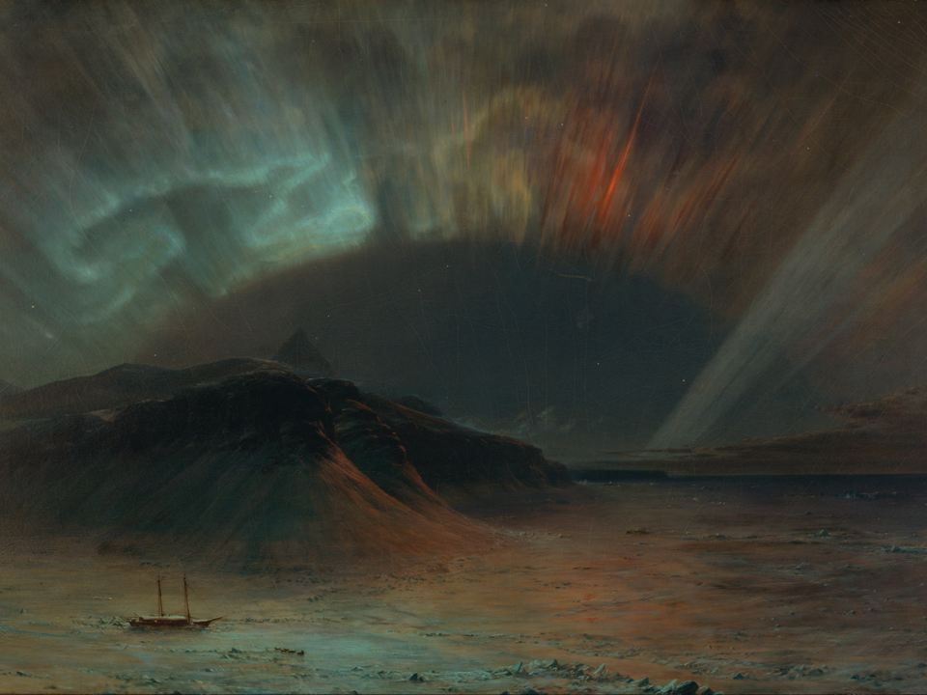
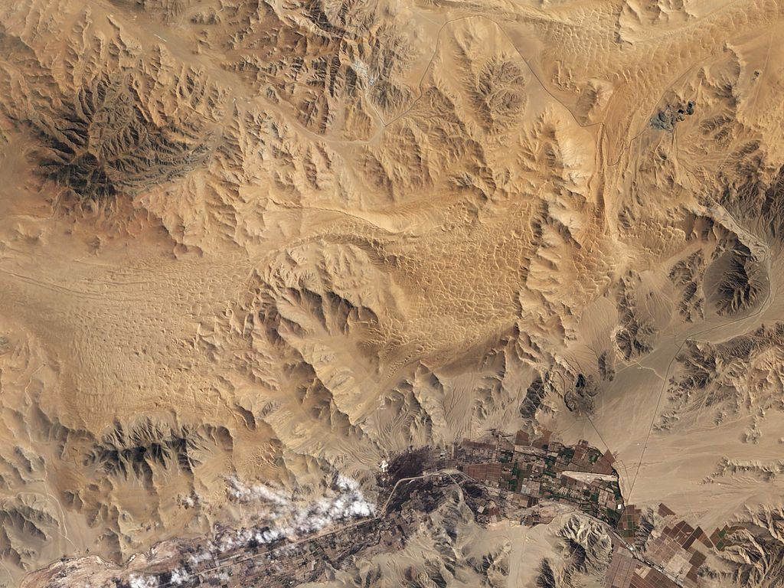

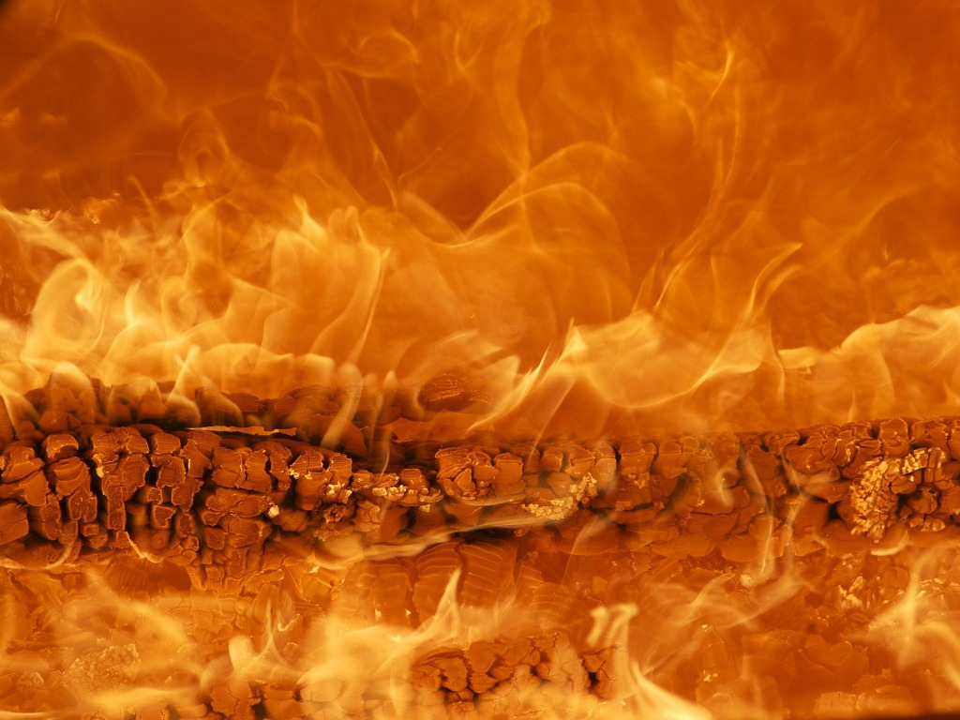
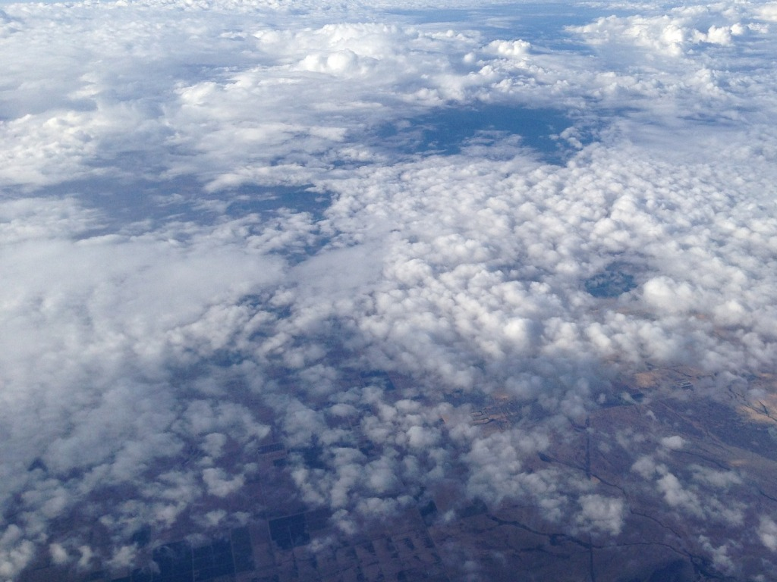
Out Of Your Element
Game Developers:
Savi Mohan
Ira Syamira

Slide 2
Basic Features of the Game
Easy to use GUI that can be controlled using the keyboard (screens, pause, exit, show screenshots of system)
Paddle (controlled by players themselves or AI)
Screen resolution (1024x768)
Timer (timer indicated at the top of the game screen, easy for viewing)
Sound effects (different sound effects for different events)
Available in three different modes: 1. Single player 2. Multiplayer 3. Demo mode
Multiplayer mode allows up to 4 human players (no AI involved)

Slide 3
Top-Level View of the System
Game Menu
Game modes
Single player
Multi player
Demo
Levels/Modes
Level 1
Level 2
Normal mode
Level 3
Level 4
3-ball mode
Final level
No walls mode
Features
Paddles
Paddles
Paddles
Field spells
Field spells
Balls
Walls
Walls
Obstacles
Balls
Balls
Walls
Obstacles
Obstacles
Maps
Maps
Notes:
This diagram is to show the client how the system works and the options and features they will encounter when using the system

Slide 4
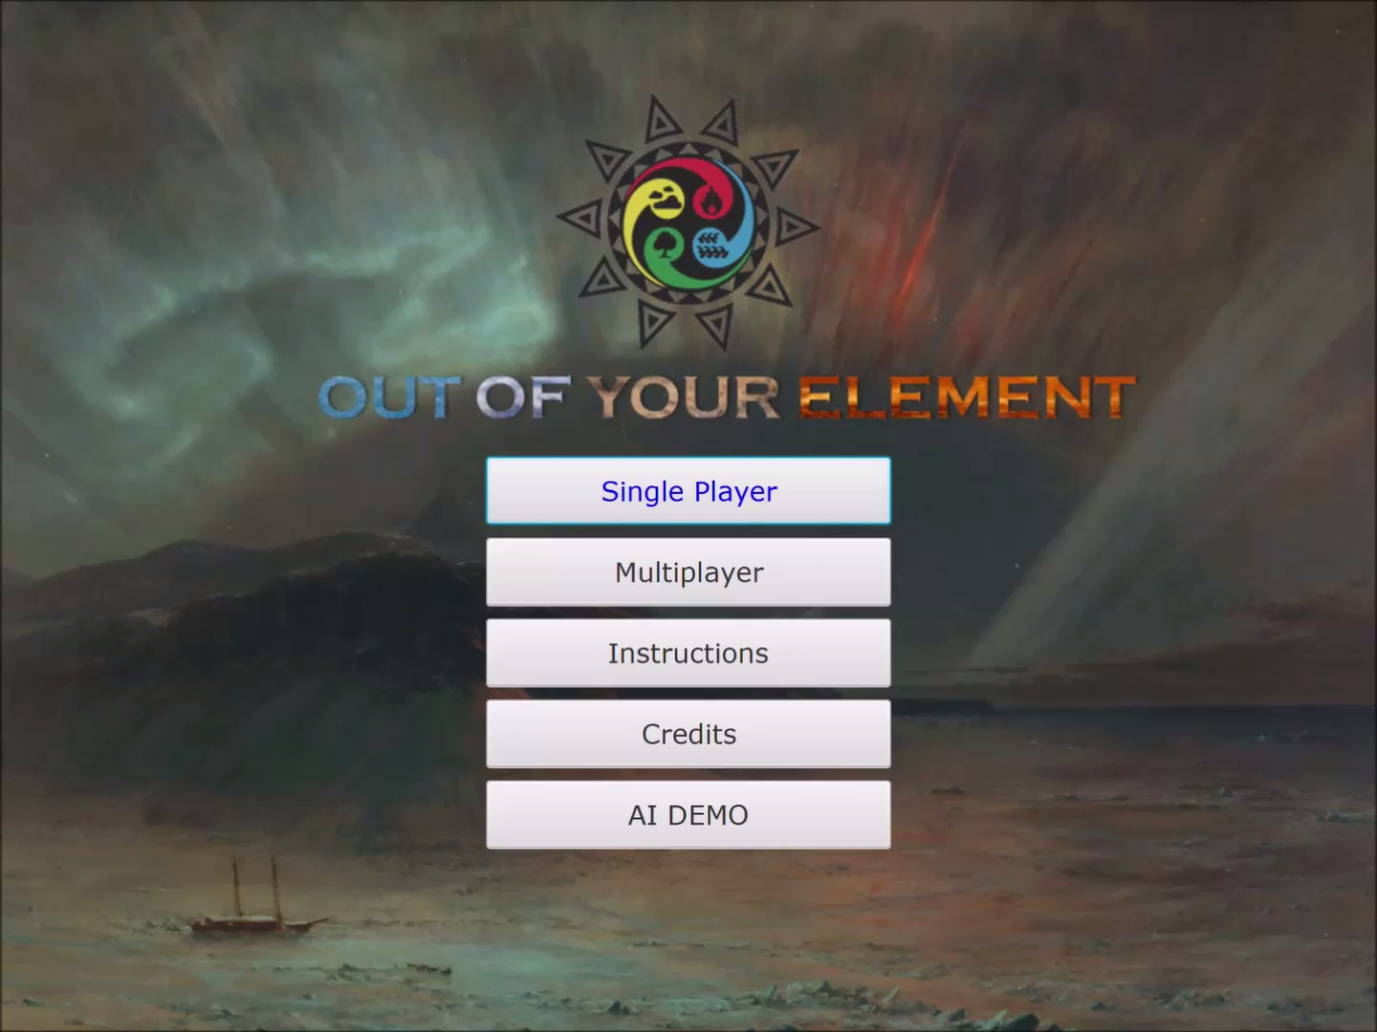
Game Demo
Notes:
This is a short 1-min demo on the same and the different features (maps, obstacles and field spells) available.

Slide 5
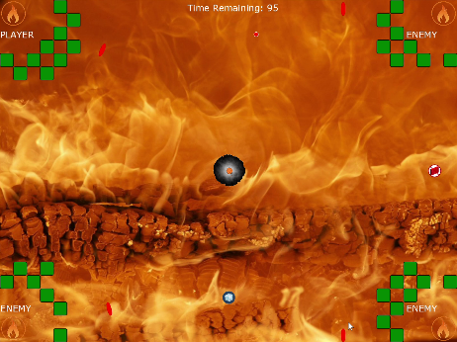
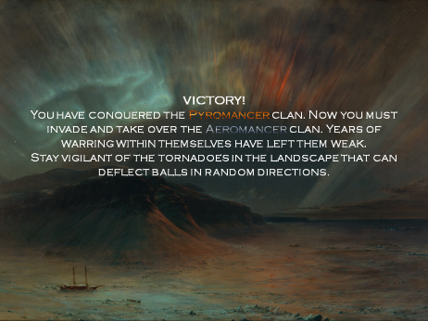
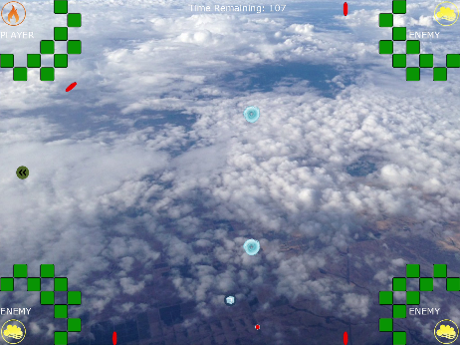
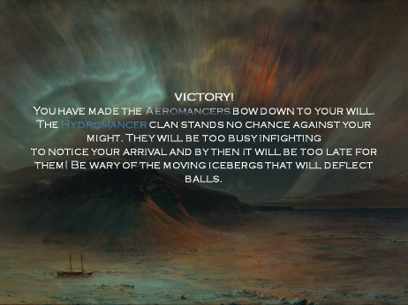
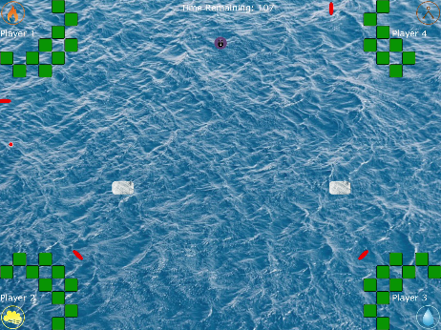
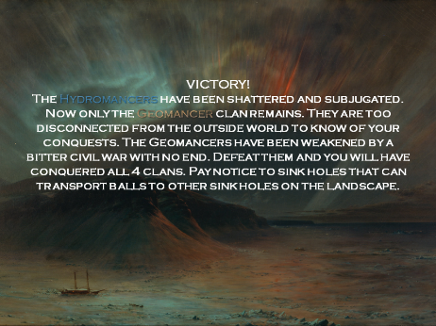
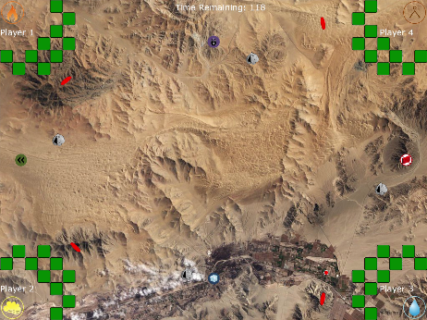
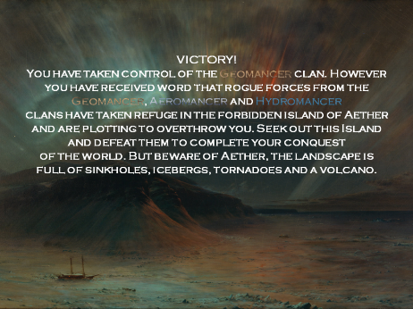
Highlighted Features of the System
Storyline
The story has an elemental theme and centers on a general in the pyromancer clan who sees that the clans of their world are weakened by infighting and ripe for conquest. The story follows the general in their bid to take over the pyromancer clan and then subsequently the aeromancer, hydromancer and geomancer clans. In the final level, the 3 clans that you warred against will unite and mount an attempt to defeat you.

Slide 6
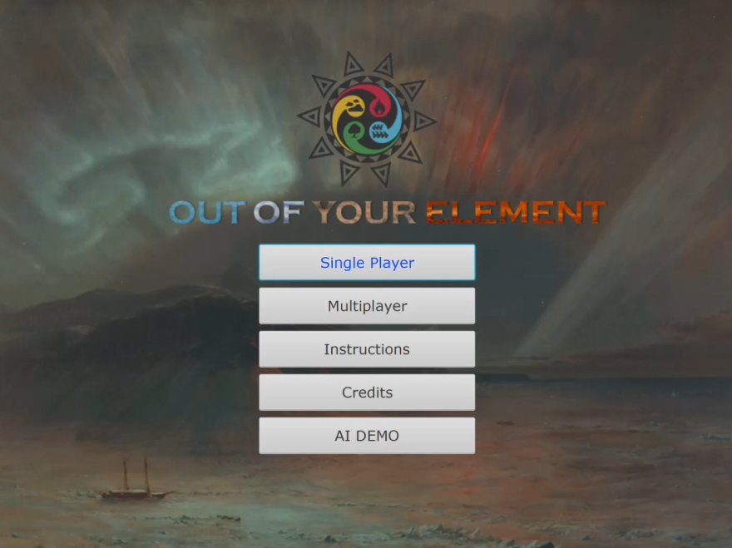

Highlighted Features of the System
GUI – easily accessible using both mouse and keyboard
Screen switching and menu selection can be easily navigated through the use of keyboard.
Using keyboard (video demo)
Using mouse (video demo)

Slide 7
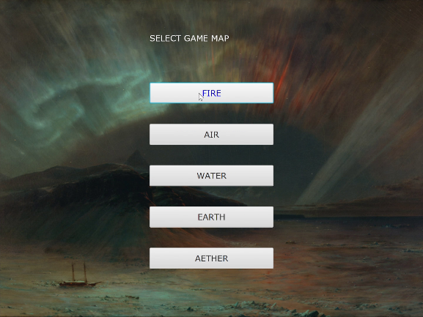


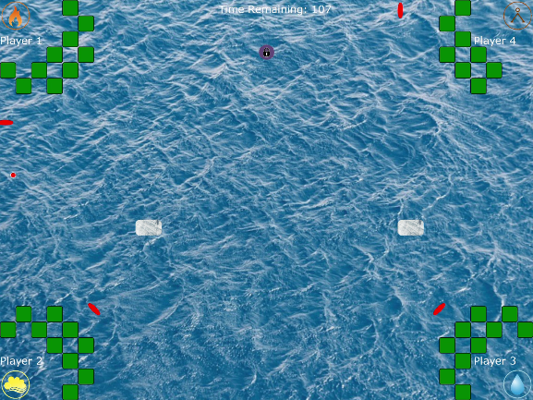

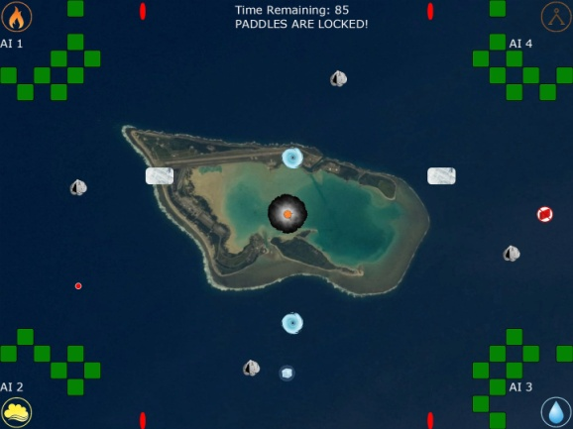
Highlighted Features of the System
Design and aesthetics
The GUI and game screen design as a whole is themed based on the game’s storyline. The levels in the game itself has different maps representing the clan warred against. The obstacles are also designed in such a way that each element has a different obstacle exclusive to it.

Slide 8
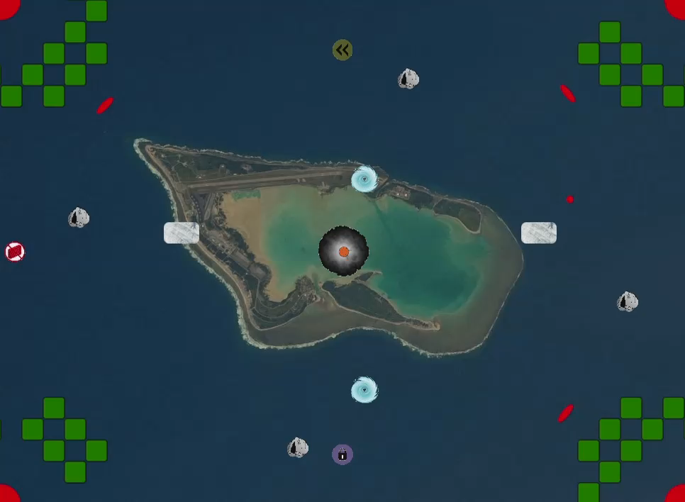
Additional Features
Elemental obstacles
Sinkholes
Teleports ball to another sinkhole on the map
Iceberg
Moving iceberg that obstructs the path of the balls
Volcano
Shoots out fireballs that destroys a player/wall
Tornado
Spinning obstacle that deviates the path of balls
Field spells
Disappearing wall
Makes the walls disappear temporarily
2x speed ball
Balls move twice its default speed
Frozen obstacles
All moving obstacles are frozen
Paddle lock
Locks all paddles
Field spell
(2x speed ball)
Obstacle
(Sinkhole)
Obstacle
(Sinkhole)
Obstacle
(Tornado)
Field spell
(Frozen obstacles)
Obstacle
(Iceberg)
Obstacle
(Iceberg)
Obstacle
(Volcano)
Field spell
(Disappearing wall)
Obstacle
(Sinkhole)
Obstacle
(Tornado)
Obstacle
(Sinkhole)
Field spell
(Paddle lock)
The movement of obstacles and field spells (video demo)

Slide 9
How we have met your specifications
Minimum project requirements are fulfilled
System functionality is at its best
Has additional features intended to enhance gaming experience
Navigation made easy (GUI)

